Slide 1
Chares: Message-Driven Objects
Defining Chares and Understanding Asynchrony
© 2018 L. V. Kale at the University of Illinois Urbana

Slide 2
Hello World with Chares
hello.ci
hello.cpp
mainmodule hello {
mainchare Main {
entry Main(CkArgMsg ∗m);
};
chare Singleton {
entry Singleton();
};
};
#include “hello.decl.h”
class Main : public CBase_Main {
public: Main(CkArgMsg∗ m) {
CProxy_Singleton::ckNew();
};
};
class Singleton : public CBase_Singleton {
public: Singleton() {
ckout << “Hello World!” << endl;
CkExit();
};
};
#include “hello.def.h”
ci file is processed to generate code for classes such as Cbase_Main, Cbase_Singleton, Cproxy_Singleton
Notes:
CkExit global termination

Slide 3
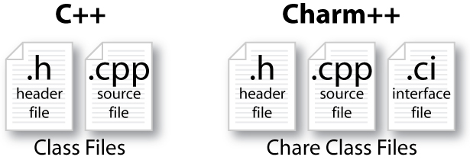
Charm++ File Structure
C++ objects (including Charm++ objects)
Defined in regular .h and .cpp files
Chare objects, entry methods (asynchronous methods)
Defined in .ci file
Implemented in the .cpp file
Hello World Example
Compiling
charmc hello.ci
charmc -c hello.cpp
charmc -o hello hello.o
Running
./charmrun +p7 ./hello
The +p7 tells the system to use seven cores

Slide 4
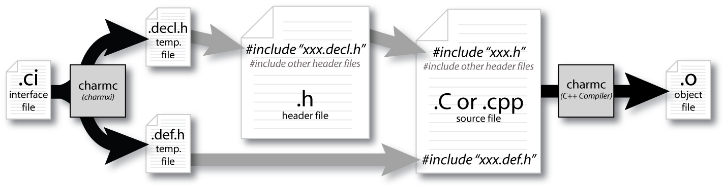
Compiling a Charm++ Program

Slide 5
Hello World with Chares
hello.ci
hello.cpp
mainmodule hello {
mainchare Main {
entry Main(CkArgMsg ∗m);
};
chare Singleton {
entry Singleton();
};
};
#include “hello.decl.h”
class Main : public CBase_Main {
public: Main(CkArgMsg∗ m) {
CProxy_Singleton::ckNew();
};
};
class Singleton : public CBase_Singleton {
public: Singleton() {
ckout << “Hello World!” << endl;
CkExit();
};
};
#include “hello.def.h”
Notes:
CkExit global termination

Slide 6
Charm Termination
There is a special system call CkExit() that terminates the parallel execution on all processors (but it is called on one processor) and performs the requisite cleanup
The traditional exit() is insufficient because it only terminates one process, not the entire parallel job (and will cause a hang)
CkExit() should be called when you can safely terminate the application (you may want to synchronize before calling this)
L.V.Kale

Slide 7
Entry Method Invocation Example: .ci file
mainmodule MyModule {
mainchare Main {
entry Main(CkArgMsg ∗m);
};
chare Simple {
entry Simple(double y);
entry void findArea(int radius, bool done);
};
};

Slide 8
Does This Program Execute Correctly?
struct Main : public CBase_Main {
Main(CkArgMsg∗ m) {
CProxy_Simple sim = CProxy_Simple::ckNew(3.1415);
for (int i = 1; i < 10; i++) sim.findArea(i, false);
sim.findArea(10, true); } };
struct Simple : public CBase_Simple {
double y;
Simple(double pi) { y = pi; }
void findArea(int r, bool done) {
ckout << “Area:” << y∗r∗r << endl;
if (done) CkExit(); } };

Slide 9
No! Methods Are Asynchronous
If a chare sends multiple entry method invocations
These may be delivered in any order
Output:
Area: 254.34
Area: 200.96
Area: 28.26
Area: 3.14
Area: 12.56
Area: 153.86
Area: 50.24
Area: 78.50
Area: 314.00
Area: 28.26
Area: 78.50
Area: 3.14
Area: 113.04
Area: 314.00
sim.findArea(1, false);
...
sim.findArea(10, true);
or
Simple::findArea(int r, bool done){
ckout << “Area:” << y∗r∗r << endl;
if (done) CkExit(); } };
if (++count == 10) CkExit(); } };
Notes:
Change bool to count

